Slide 1
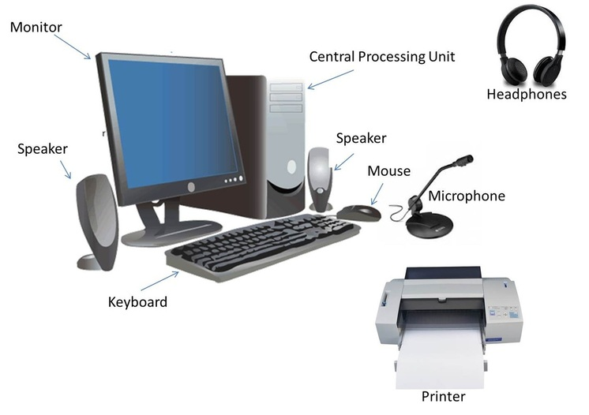
Components of computer
Instructor : ENGR. HIRA AKASH

Slide 2
Basic Diagram
COMPUTER
Processor or CPU
Input Devices
Output Devices
Memory

Slide 3
Input Unit
Input is any data or instructions entered into the memory of a computer .
Any hardware component allows user to enter data and instructions in to a computer.
Keyboard and Mouse are the most common input devices which are used.

Slide 4
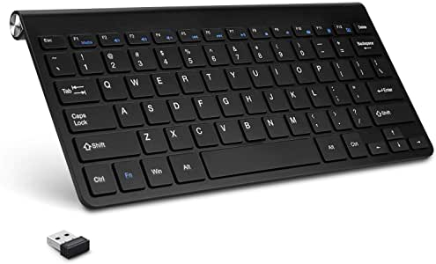
Keyboard
Used to enter information into the computer and for giving commands.
A standard computer keyboard is called a QWERTY keyboard

Slide 5
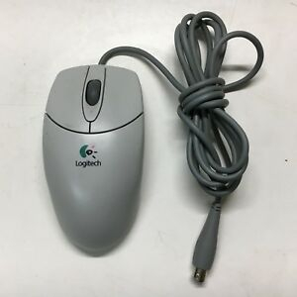
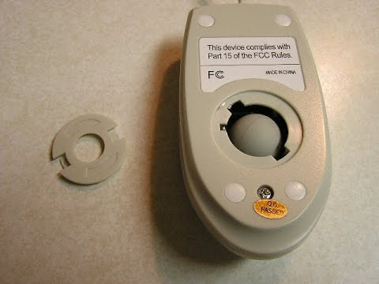
Ball Mouse
An input device operated by rolling its ball across a flat surface.
The mouse is used to control the on- screen pointer by pointing and clicking, double- clicking, or dragging objects on the screen.

Slide 6
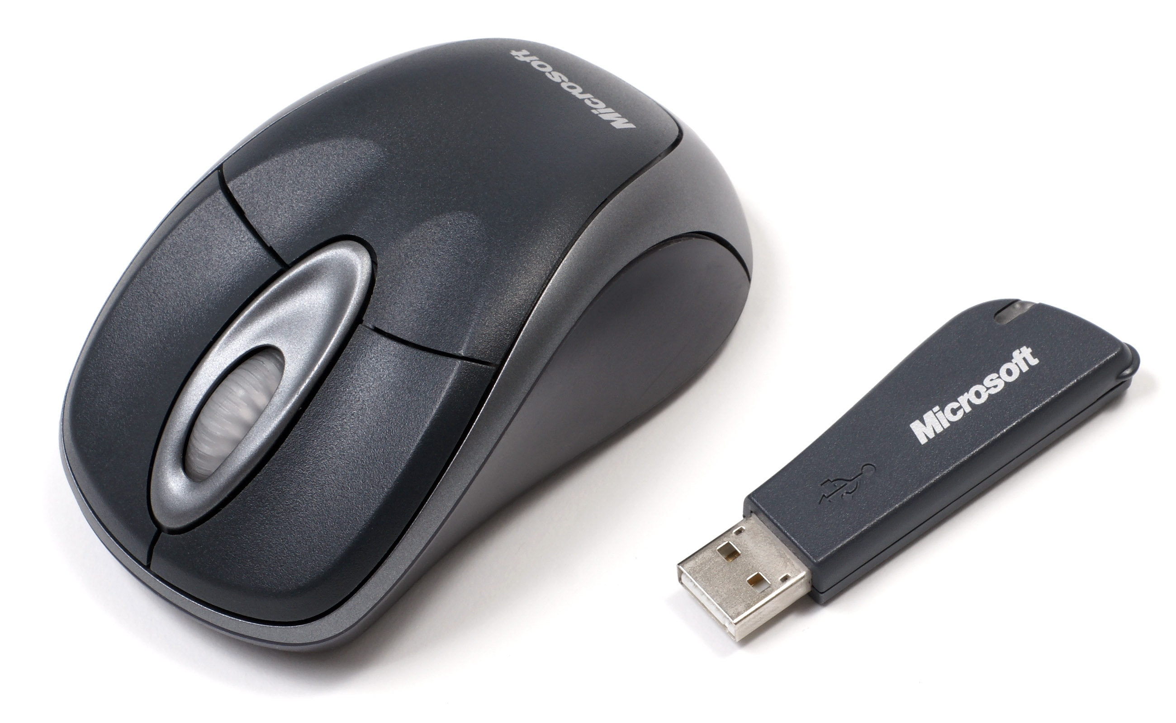
Optical Mouse
It is an advanced computer pointing device.
It uses Light-Emitting Diode(LED) in place of the traditional mouse ball.
Movement is detected by sensing changes in reflected light.

Slide 7
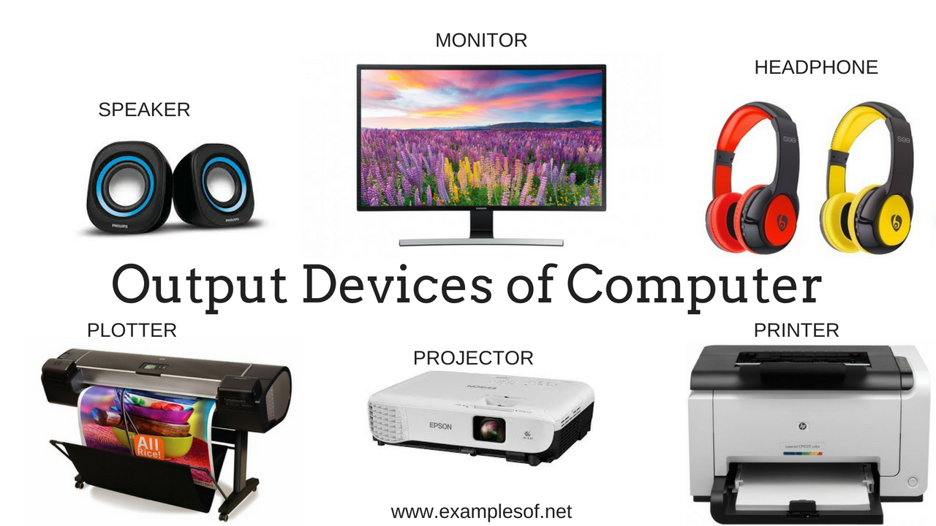
Output Unit
The job of output unit is just the reverse of that of an Input Unit.
It supplies information and results of computation to the outside world.
Monitor and Printer are the most common Output Devices which are used.

Slide 8
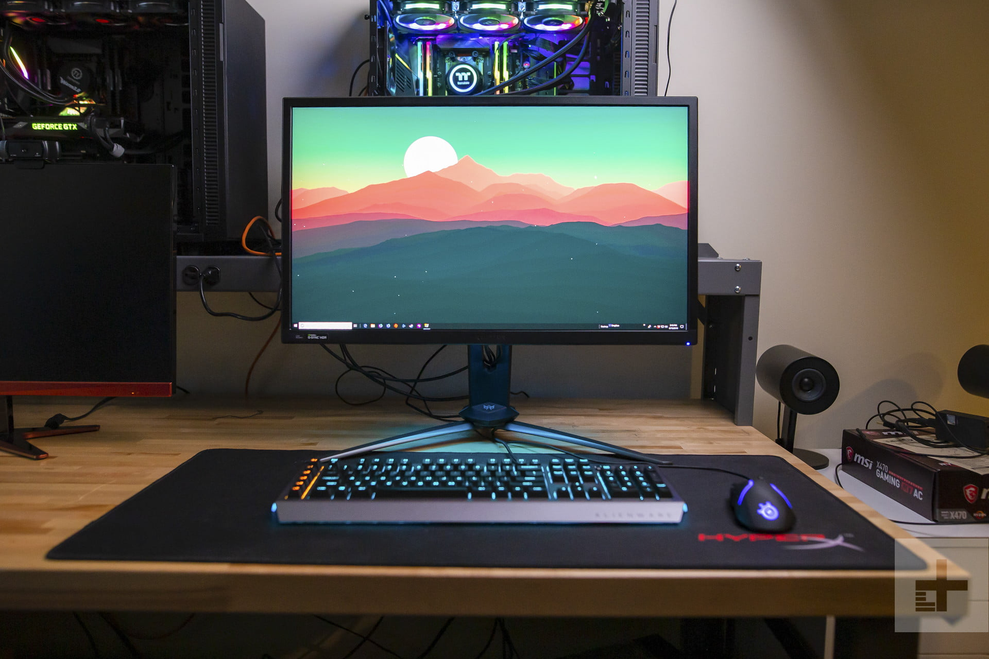
Monitor
A display screen is used to provide “output” to the user.
It is where you can view the information you are working on.

Slide 9
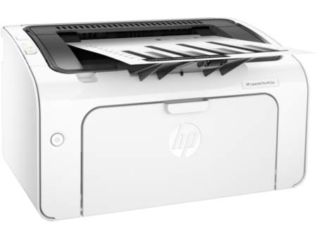
Printer
An output device that produces a hard of the information.
Information to the user is in printed form.

Slide 10
Memory / Storage Devices
All computer need to store data.
Data is stored temporally while program is running
Main Memory.
To store data for long-term, to preserve programs and data while not in use
Backing Storage.
Primary Memory and Secondary Memory

Slide 11
Primary Memory
Temporary area for holding data.
To store the program currently being executed
To hold data produced while the program is running.
Primary Memory are of two types
RAM
ROM

Slide 12
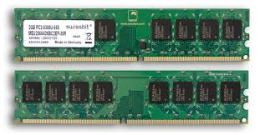
RAM(Random Access Memory)
Major portion of the Primary Memory
Memory that is used by the program in execution
If the computer gets turned off, RAM will lose all the data.
Static RAM
Dynamic RAM

Slide 13
Static RAM
The memory retains as long as power remains applied.
Uses Flip Flop circuitry.
Is more faster.

Slide 14
Dynamic RAM
Need continues Refreshing in order to maintain the data.
It uses transistors and capacitors in circuits
Slow and consumes more power

Slide 15
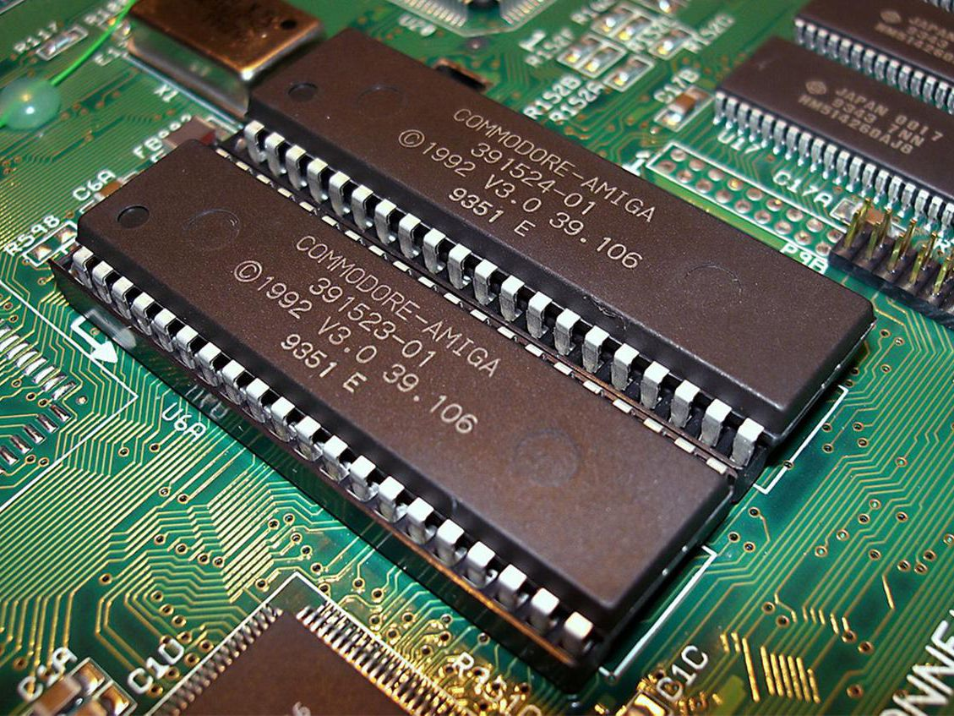
ROM (Read Only Memory)
Memory which we can only read but cannot write on.
Non-volatile.
Used to store some firmware programs.
PROM – Programmable Read Only Memory
EPROM – Erasable and Programmable read Only Memory.
EEPROM – Electrically Erasable and Programmable read Only Memory.

Slide 16
Secondary Memory
Permanent memory of the system.
More storage capacity.
It is the Backing Store.
Magnetic Disk
Optical Disk

Slide 17
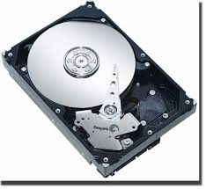
Magnetic Disc
Stored data in the form of Magnetic directions.
Hard Disk
Floppy Disk

Slide 18
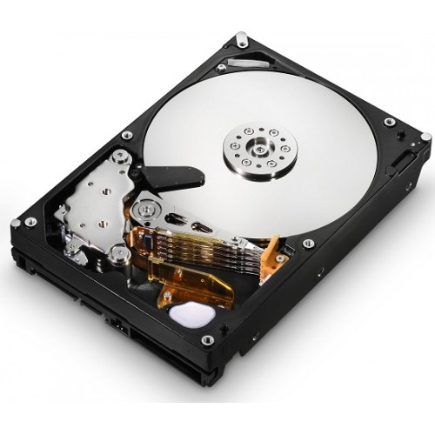
Hard Disk
Access to data is far faster than access to data in floppy disks.
Read/Write Head is positioned close to the disk.
Disk is attached to a spindle.
Spindle is rotated by a motor.
Speed of disk depends on the speed of motor.

Slide 19
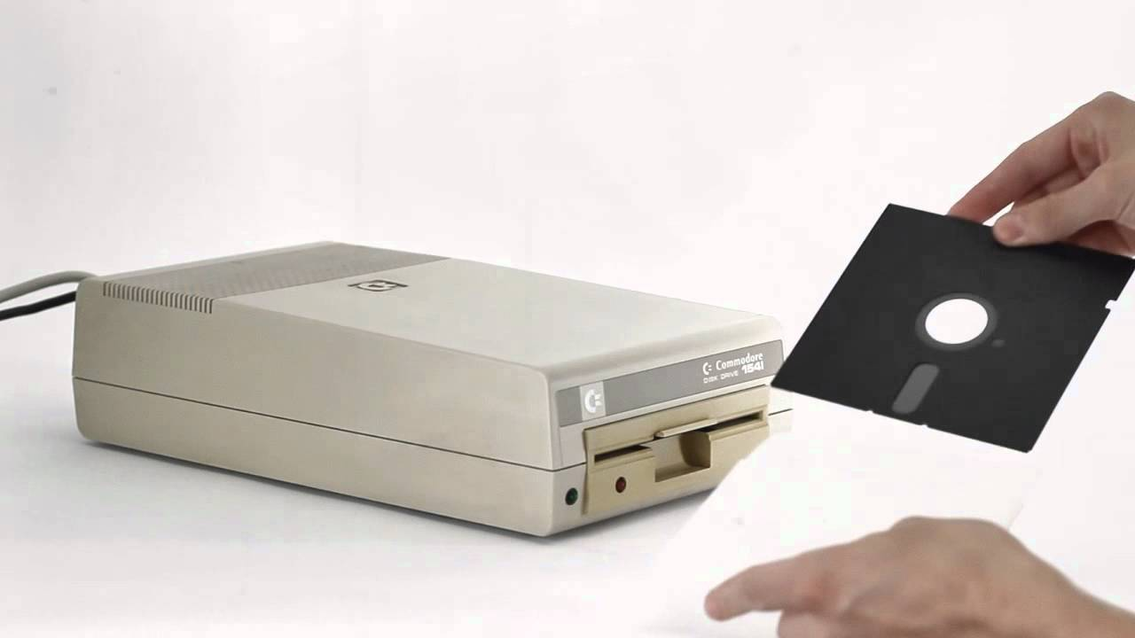
Floppy Disk
Consists of a plastic disk coated with iron oxide.
Disk access mechanism is arranged as a hardware unit called disk drive.
Drive contains motor, Read/Write Head etc.
Head comes in contact with the disk through the data access area.
Disk is rotated to pass the sectors through the head.

Slide 20
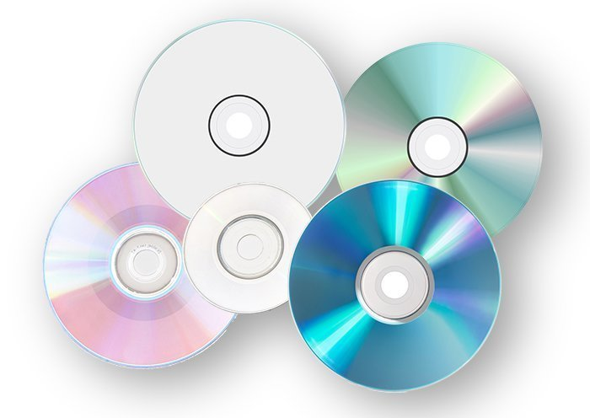
Optical disk
It is an electronic storage medium.
Read operation is done using low powered laser beam.
A laser read the dots and then the data is converted to an electrical signal .
The output form of this devise is in audio and visual format
CD-ROM – Compact Disk-Read Only Memory.
CD – R – Compact Disk – Recordable.
CD-RW – Compact Disk – Rewritable
DVD – ROM – Digital Versatile Disk – Read Only Memory
DVD – RAM - Digital Versatile Disk – Random Access Memory

Slide 21
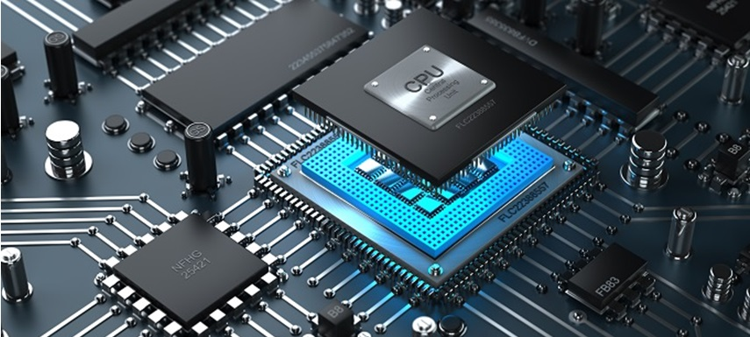
Processor Or CPU
The CU and ALU are jointly known as CPU.
Brain of the computer.
Perform data processing operations.
Control the working of the entire system.
Arithmetic and Logic Unit (ALU) & Control Unit(CU)

Slide 22
Arithmetic and Logic Unit ( ALU )
Place where the actual execution of the instructions take place during the processing operations.
All calculations are performed here.
It consists of circuits that perform arithmetic as well as logical operations

Slide 23
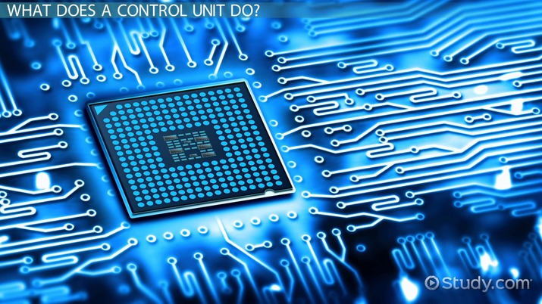
Control Unit
It act as a central nervous system for the other components of the computer.
It manages and coordinates the entire computer system.
It get information from the main memory
It issues signal to control every other units of the system.

